Slide 1
2022 2023 MUSIC PROGRAM

Slide 2
WHY MUSIC?
Do something cool and unique!
Make new friends!
Improve your chances of success in school*
*source

Slide 3
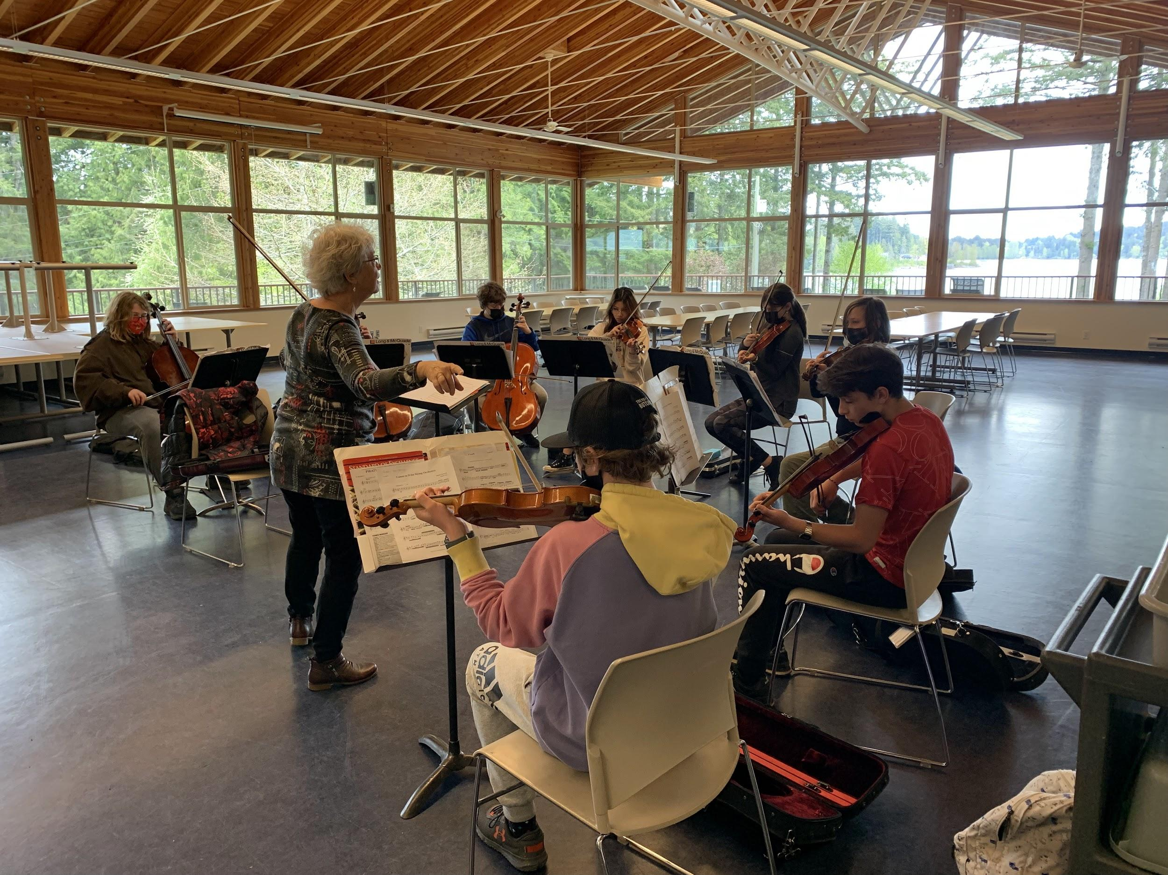
WHAT IS THE MUSIC PROGRAM LIKE?
Enrichment opportunity to learn a band or strings instrument, or to sing in the choir.
It takes place during the school day.
We do field trips and events.
Open to everyone!

Slide 4
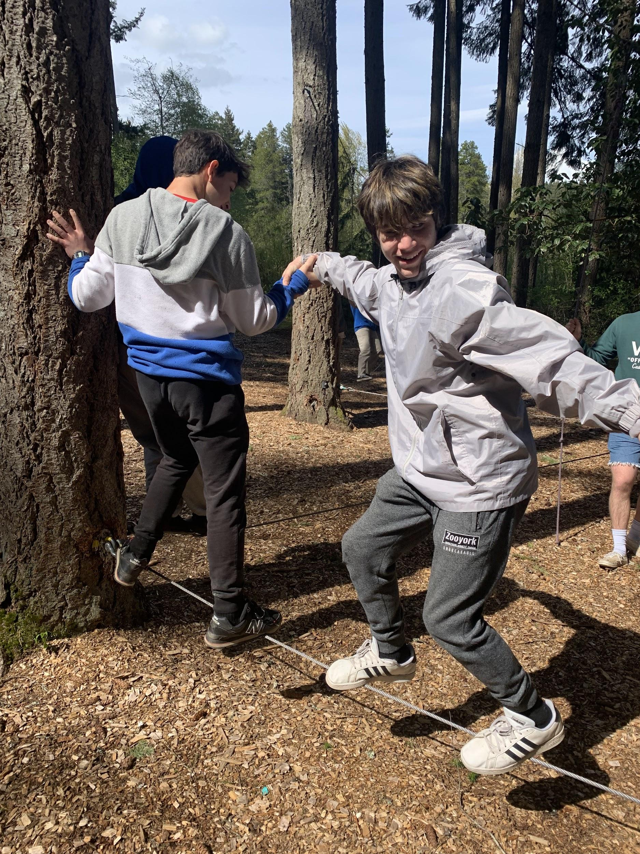
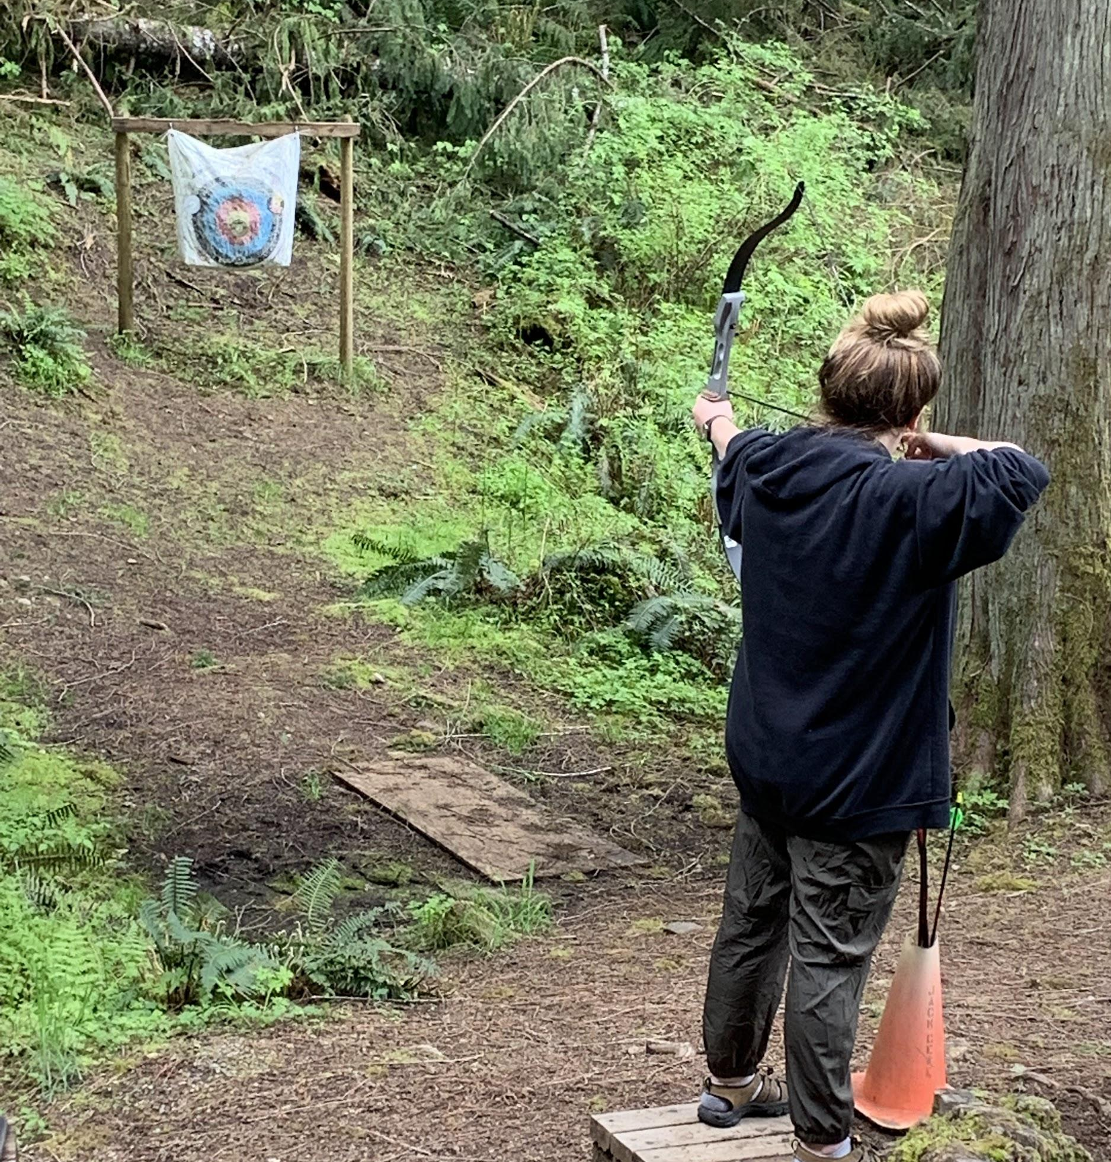
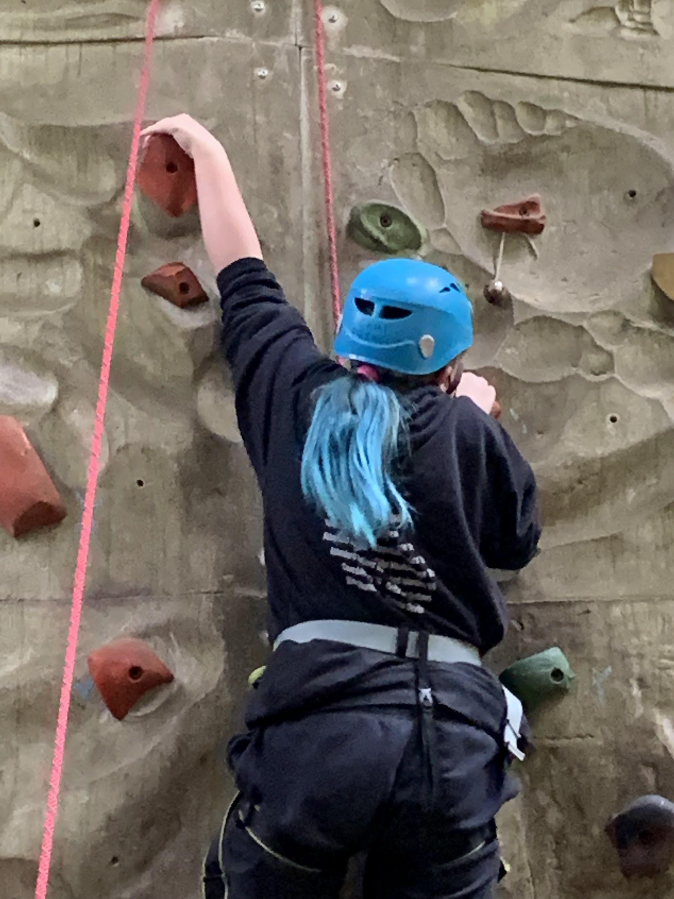
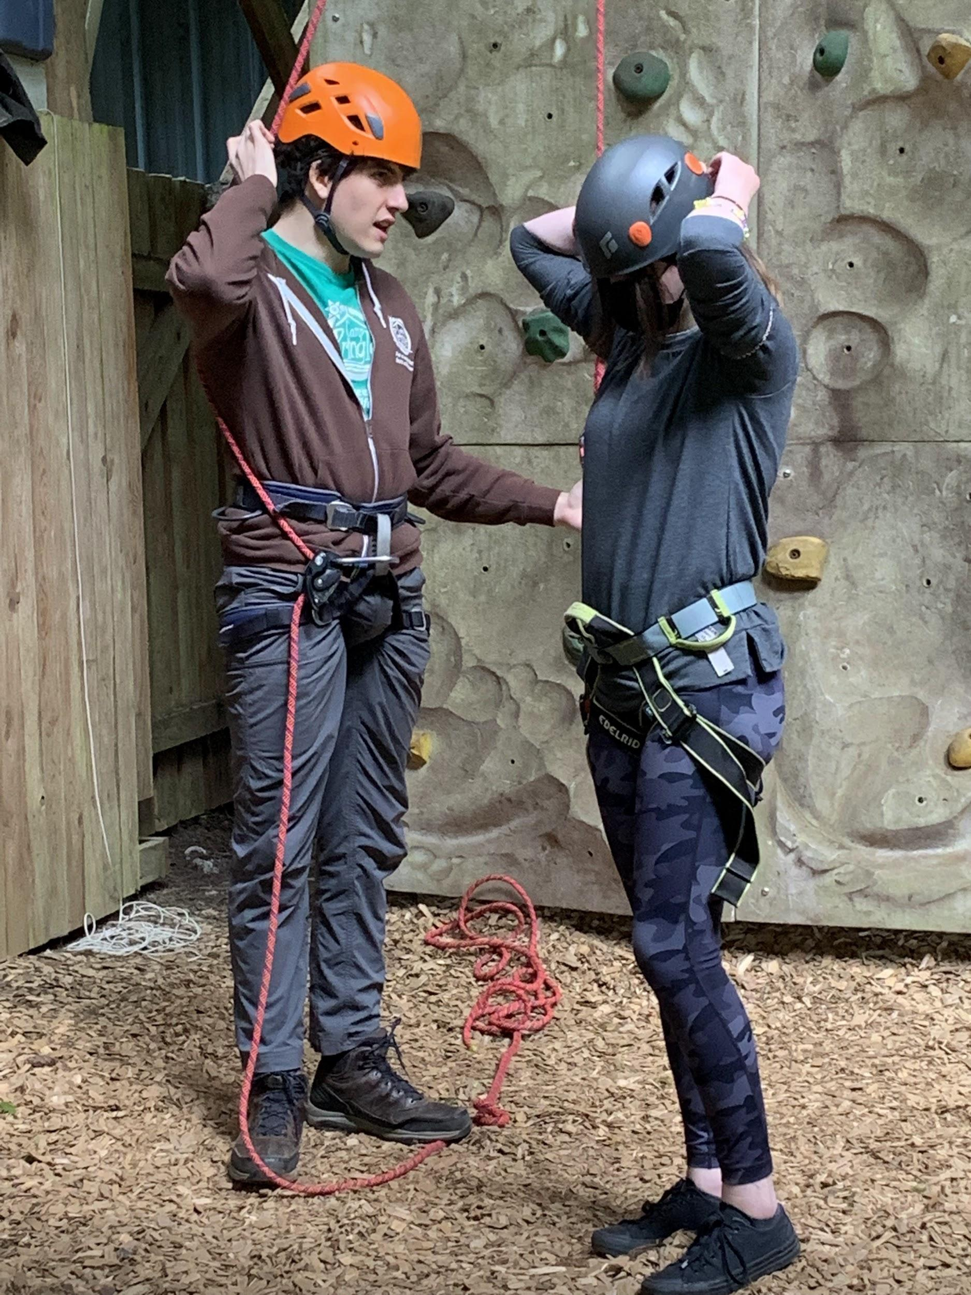
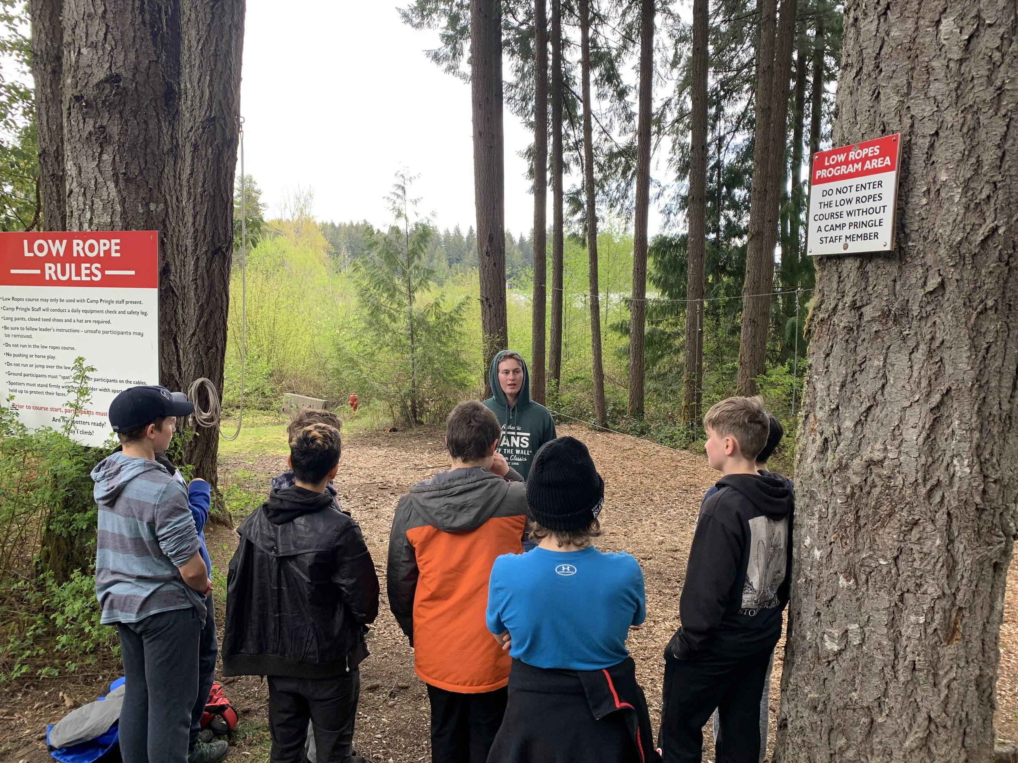

Slide 6
WHICH OF THESE CELEBRITIES TOOK MUSIC IN SCHOOL?
THEY ALL DID! (AND MANY MORE DID, TOO!)

Slide 7
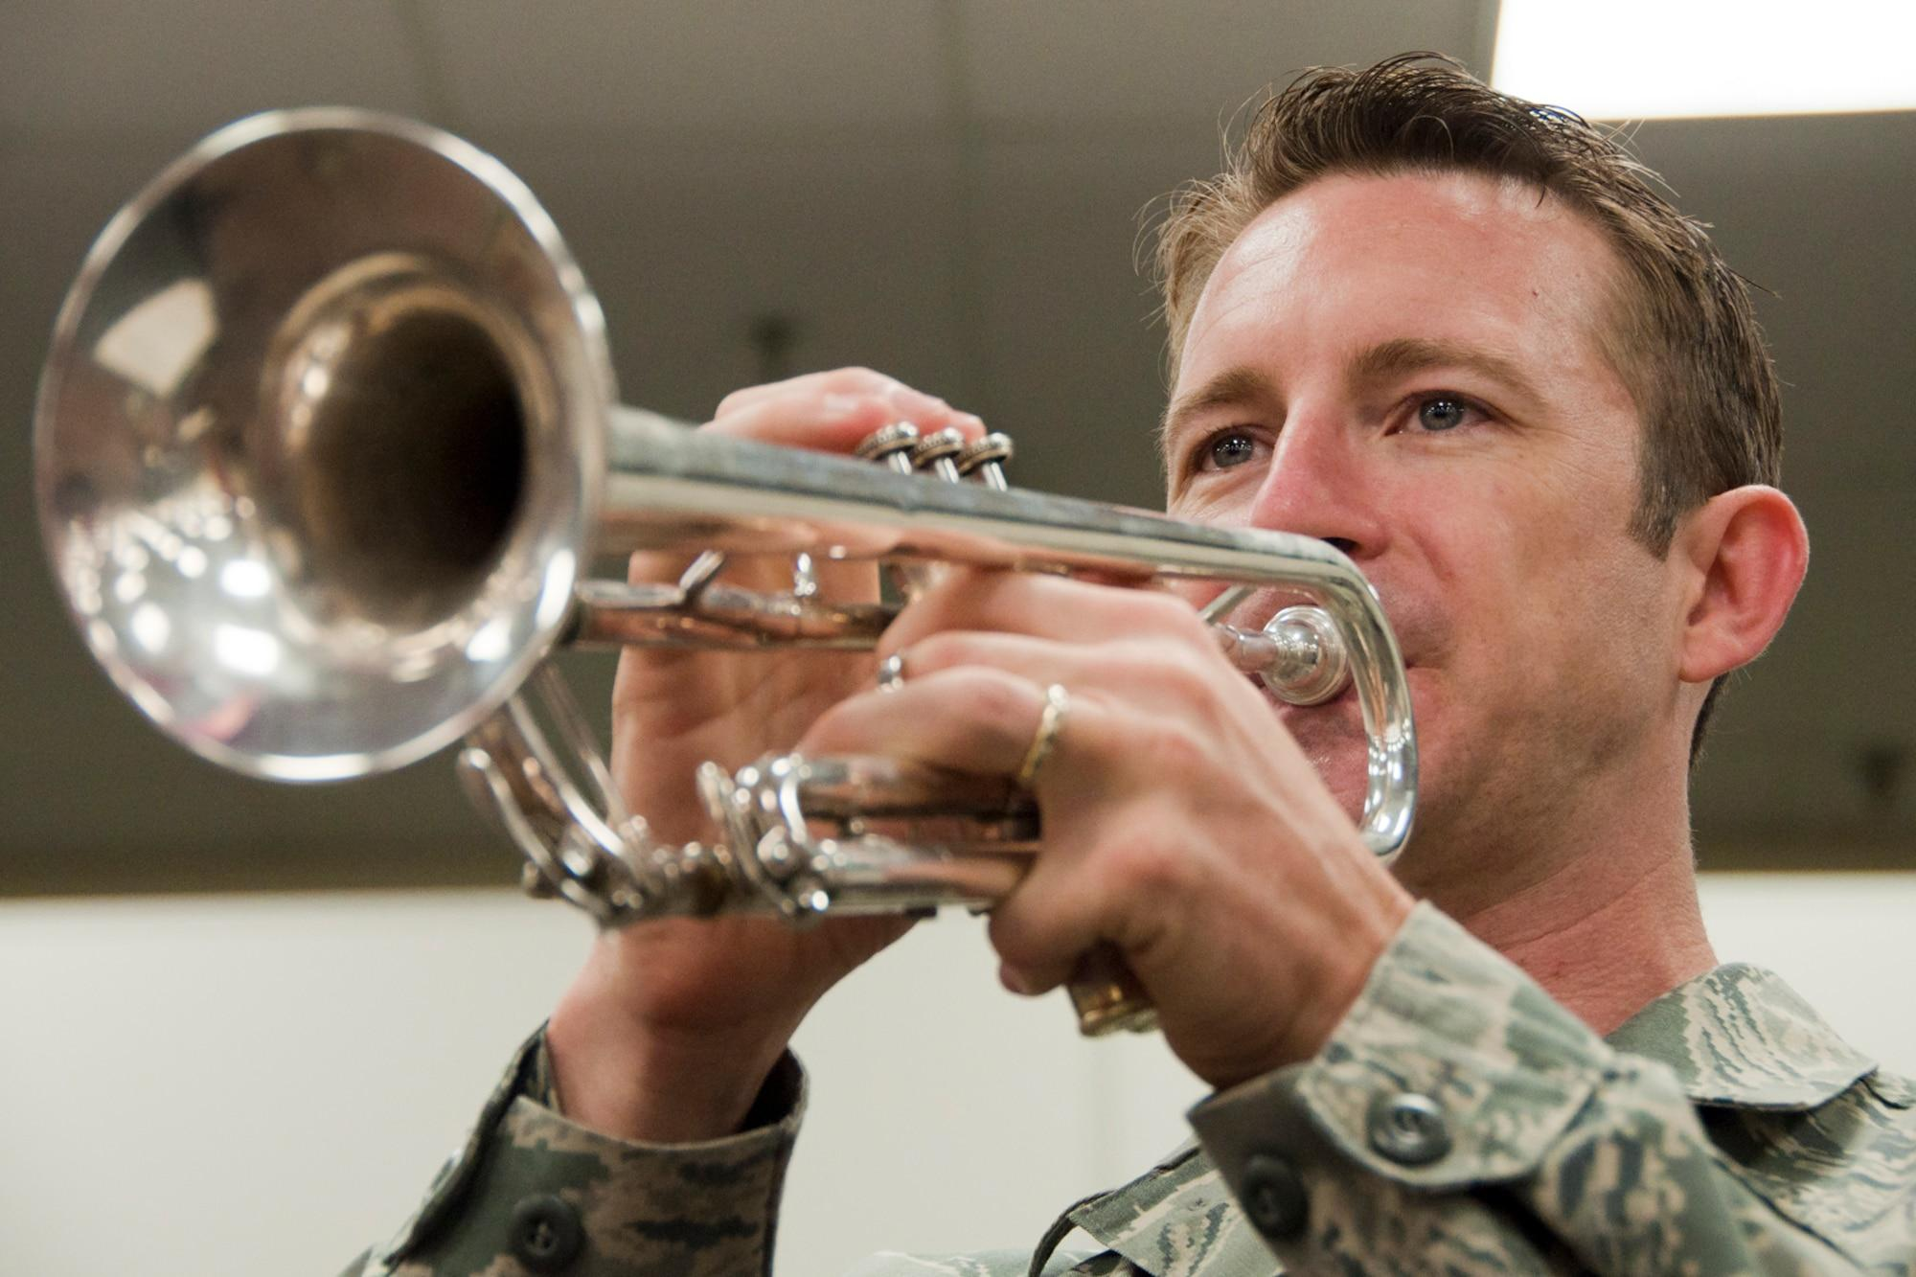
WHICH OF THESE INSTRUMENTS IS A “BAND” INSTRUMENT”?
THEY ALL ARE!

Slide 8
I’M STILL NOT SURE…
Now is THE TIME to give it a try!
Here are some things to consider…

Slide 9
Class Times
These are “pull-out” enrichment classes, so you will leave your advisory class to participate.
Choir
Wednesdays 3rd block
Band
Mondays, 4th block and Wednesdays, 1st block
Strings
Tuesdays, 4th block and Thursdays, 4th block
Listen to morning announcements for reminders, or check rockheightsmusic.com

Slide 10
Other things to consider…
These are not clubs - attendance at all classes is expected
You will receive a report card for them.
There are 2 major concerts (Winter and Spring) which you are expected to attend.
There are some other festivals, field trips and performances which you are strongly encouraged to attend.
We perform in a uniform (our red Rockheights Music t-shirts)

Slide 11
Choir is the easiest way to get involved!
We have only one in-timetable class per week.
We sing lots of styles of music.
We sing in different languages.
We perform more than any other ensemble at school.
You are strongly encouraged to learn to read music, but not as much as in band or strings.
.

Slide 12
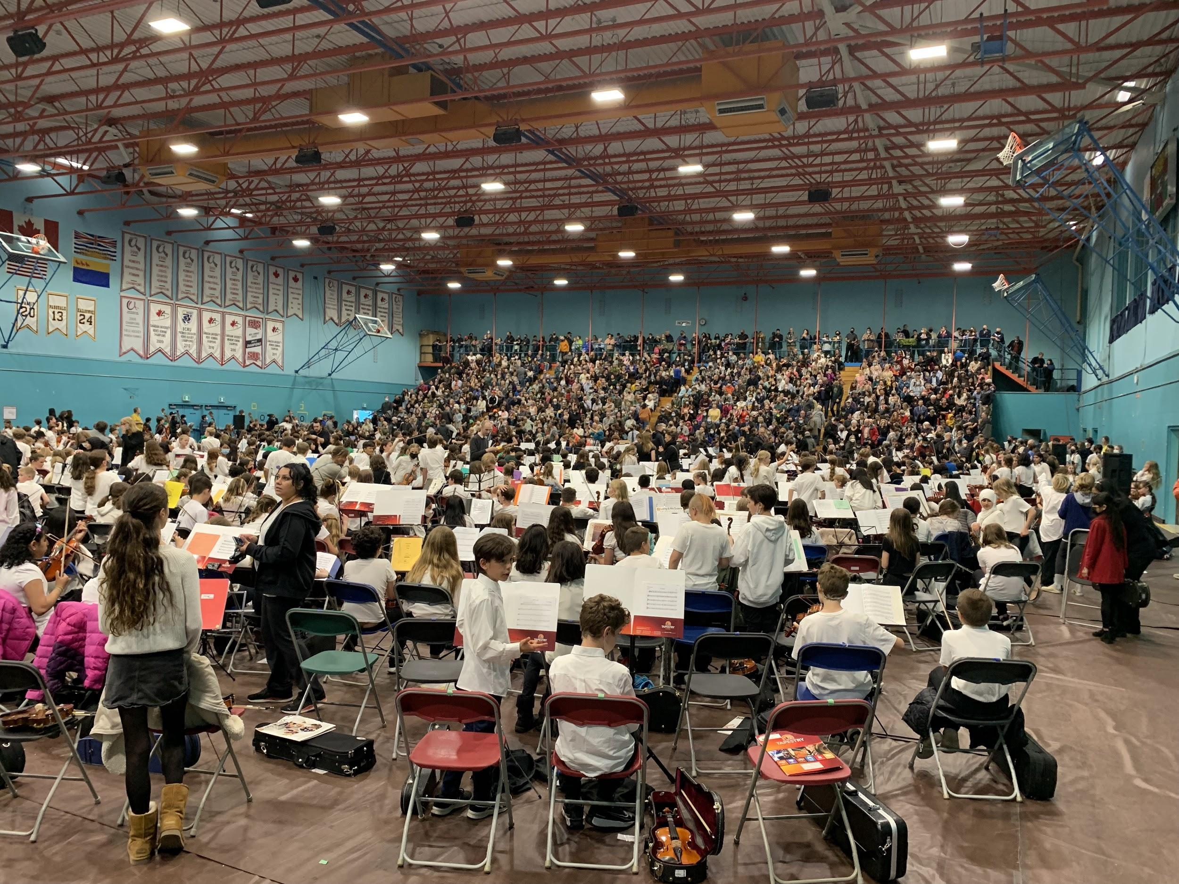
Band and Strings require a bit more…
Band and Strings have 2 in-timetable classes per week.
We play lots of different styles of music.
You will be responsible for your instrument.
You will learn how to read music.

Slide 13
Choosing an Instrument to Play
Band | Strings
Woodwind, brass and percussion | Violin, viola, cello and upright bass.
Can play ANY style of music. | Can play ANY style of music
Larger class | Smaller class
Can add Jazz Band later | Can play in orchestra later

Slide 14
The instruments to choose from in Band
In order from highest to lowest in pitch
Woodwinds | Brass | Percussion
Flute Oboe* Clarinet Bass Clarinet* Saxophone (alto, tenor, bari*) Bassoon* | Trumpet French Horn Trombone Baritone / Euphonium Tuba* | Percussionists play all of these: Drums, and drum-kit Cymbals Timpani Mallet percussion Hand percussion
Electric bass guitars, which are string instruments, are also allowed to play in band.

Slide 15
The instruments to choose from in Strings
Violin | Viola | Cello | Upright Bass
Highest Smallest Also called a “fiddle” Held on your shoulder | Next lowest Reads in alto clef Always needed! Held on your shoulder | Next lowest Reads in bass clef Sit on the floor between your knees | Lowest Sits on the floor and you stand or sit on a stool. One of the most versatile instruments.

Slide 16
What are the costs involved?
$10 to purchase a Rockheights Music t-shirt to keep, or borrow one for no cost.
$20 suggested donation to rent an woodwind or brass instrument from Rockheights (a one-time fee for the whole year.)
$150-$200 to rent a violin, viola or cello from School District 61 (a one-time fee for the whole year).
You will need a few supplies, like reeds and cleaning supplies.
However…
NO STUDENT IS TURNED AWAY FROM BAND, STRINGS OR CHOIR BECAUSE OF COSTS. If your family is in financial need, please have your parents e-mail me and I will gladly help.

Slide 17
I NEED MORE DETAILS!
Class times
More Instrument Information
Events and Dates
Videos and more!
Sign-Up for Courses or to receive more information
www.rockheightsmusic.com

